Slide 1

Niet-medicamenteuze behandeling van astma
Amsterdam, 4 oktober 2017
Alex van ‘t Hul, programmadirecteur COPDnet

Slide 2

Stelling(en):
Behandeluitkomsten van astma laat ruimte voor (verdere) verbetering zien…
Samenhang longfunctiestoornis en ziektelast bij astma is zwak tot zeer zwak…
De prevalentie van aangrijpingspunten voor niet-medicamenteuze bij astma behandeld in 2e lijn in Nederland is hoog…
Studies naar niet-medicamenteuze behandeling bij astma laten belangrijke effecten zien…
Ruimere toepassing van niet-medicamenteuze behandeling bij astma gaat bijdragen aan verbeterde behandeluitkomsten
Notes:
Verder verdiepen

Slide 3
Kwaliteitsindicatoren: vooral proces en (zeer) beperkt outcome
< 2%!!!
Porter, M.E., et al. Standardizing Patient Oputcomes Measurement. N Engl J Med 2016; 374: 504-506

Slide 4



Leven met een longziekte
Omgaan met een longziekte in het dagelijks leven
Behandeling en leefstijl
Toegang tot informatie en gezondheidsvaardigheden
Gebruik van professionele zorg
Ervaren kwaliteit van zorg

Slide 8
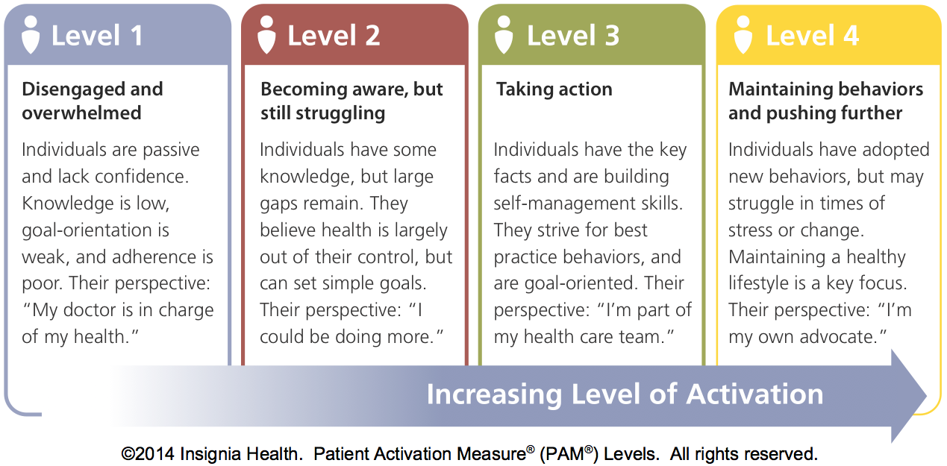
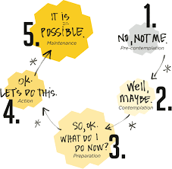

Activation for self-management in asthma or COPD patients referred to a pulmonologist
Noortje Koolen MSc.¹, dr. Alex van ’t Hul ¹, dr. Philip van der Wees ², prof. dr. Richard Dekhuijzen ¹, prof. dr. Gert Westert ², prof. dr. Yvonne Heijdra ¹
PAM level 4
PAM level 1
PAM level 3
PAM level 2
CONCLUSION
In 56% of the asthma patients and in 59% of COPD patients there is little or no degree of activation for self-management (PAM-1 and PAM-2) at the time of referral from primary to secondary care.

Slide 9
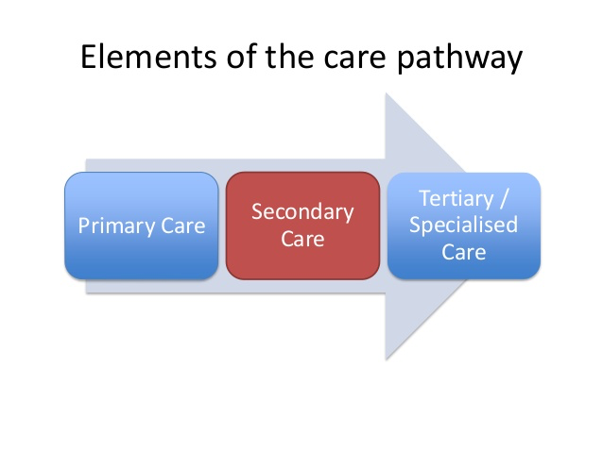



Slide 10

Outcome van 2e lijn zorg bij mensen met astma - ΔACQ
Follow-up na ½ jaar
81%
19%
Basis assessment
ACQ> 1.5
55%
33%
ACQ 0.75-1.5
40%
25%
ACQ< 1.5
20%
27%
N=142
8%
17% is klasse beter
65% is ongewijzigd
18% is klasse slechter
40%
52%

Slide 11

Outcome van 2e lijn zorg bij mensen met astma- ΔAQLQ
Klinisch relevant slechter
Δ AQLQ< - 0.5
36%
Δ AQLQ -0.5 - +0.5
45%
Indifferent
Δ AQLQ > 0.5
19%
Klinisch relevant beter
N=142
Notes:
Verder verdiepen

Slide 12
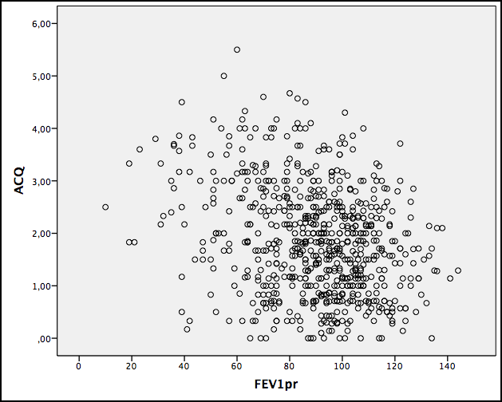
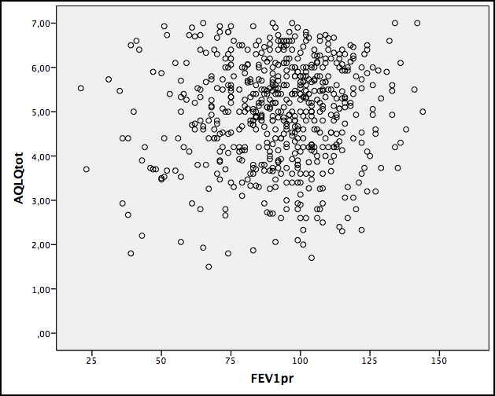
Samenhang longfunctiestoornis en ziektelast bij astma
N=775
r = -0.28
r = 0.07
Agusti A., et al. Characterisation of COPD heterogeneity in the ECLIPSE cohort. Resp Res 2010; 11: 122

Slide 13



Prevalentie van aangrijpingspunten voor niet-medicamenteuze behandeling bij astma verwezen naar 2e lijn
15% rookt
25% heeft een BMI>30
30% heeft chronisch hyperventilatie bloedgas
48% heeft een 6MWD<70%
24% sedentair, 32% laag actief, 26% enigszins actief en slechts 18% actief of hoog actief
72% heeft klinisch relevante vermoeidheid
58% heeft ernstige somberheid en 61% angst

Slide 14
Toepassing niet-medicamenteuze behandeling bij astma?
Geen Nederlands onderzoek bekend naar aantal patiënten dat jaarlijks wordt verwezen voor een of andere vorm van niet-medicamenteuze behandeling in 1e lijn of 2e lijn.
Buitenlands onderzoek laat (hele) lage cijfers zien
Het algemene gevoel is dat ook in Nederland er vaker een vorm van niet-medicamenteuze behandeling (of combinaties hiervan) zou kunnen worden toegepast.
Rochester CL, et al. An official American Thoracic Society/ European Respiratory Society policy statement: enhancing implementation, use and delivery of pulmonary rehabilitation. Am J Resp Crit Care Med 2015; 192: 1372-1386.
Notes:
Verder verdiepen

Slide 15

Aantal patiënten waarvoor verwijzing plaatshad voor niet-medicamenteuze behandeling bij COPD in het jaar voorafgaand aan verwijzing naar de 2e lijn
Verwijsaantallen naar:
Diëtist: 3%
Ergotherapeut: 2%
Fysiotherapeut: 6%
Longverpleegkundige: 3%
Psycholoog: 2%

Slide 16


Slide 17
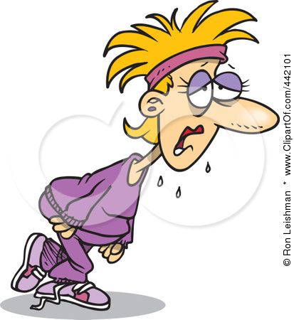

Breathing exercises
Exercise training

Slide 18
Breathing exercises

Slide 19
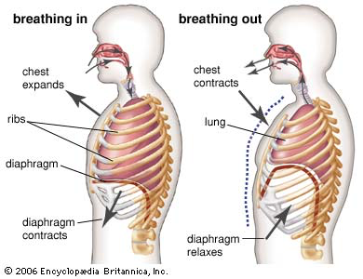
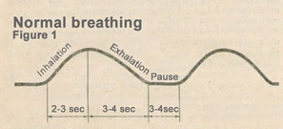
Dysfunctional breathing/ hyperventilation syndrome in asthma
Definition:
Chronic or recurrent changes in breathing pattern that cannot be attributed to a specific medical diagnosis, causing respiratory and non-respiratory complaint such as dyspnoea, chest tightness, chest pain, deep sighing, frequent yawning, anxiety, light headedness and fatigue.
spatieel
temporeel
Agache, I., et al. Dysfunctional breathing phenotype in adults with asthma – incidence and risk factors. Clin Transl Allergy 2012; 2: 18

Slide 20

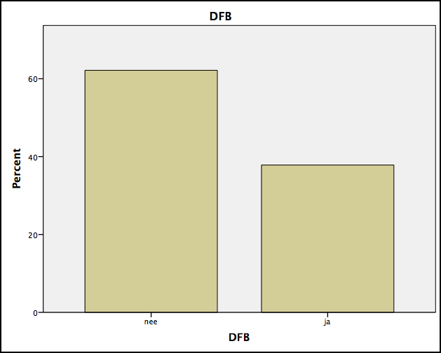


Prevalentie dysfunctional breathing bij stabiel astma
N=80
Bron: database
I. Agache, et al. Dysfunctional breathing phenotype in adults with asthma-incidence and risk factors. Clin Transl Allergy 2012; 2: 18
M. Thomas, et al. Prevalence of dysfunctional breathing in patients treated for asthma in primary care. BMJ 2001; 322: 1098-100

Slide 21
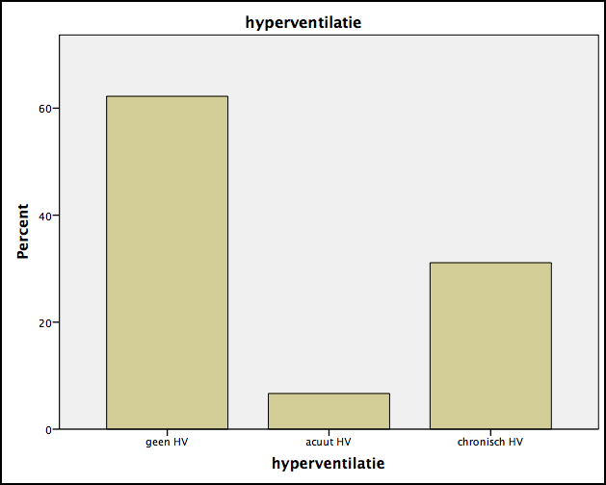

Prevalentie chronisch hyperventilatie bij stabiel astma
N=80
4.0 kPa
4.7 kPa
5.0 kPa
6.0 kPa
Bron: database
C.A. Osborne, et al. Hyperventilation and asymptomatic chronic asthma. Thorax 2000; 55: 1016-1022

Slide 22

Prevalence of hypocapnia in asthma
N=394
65% normal
5% acute HV (PCO2<4.7& BIC≥23.0)
30% chronic HV (PCO2<4.7& BIC<23.0)
Bron: database Amphia Expertisecentrum Astma& COPD.

Slide 23
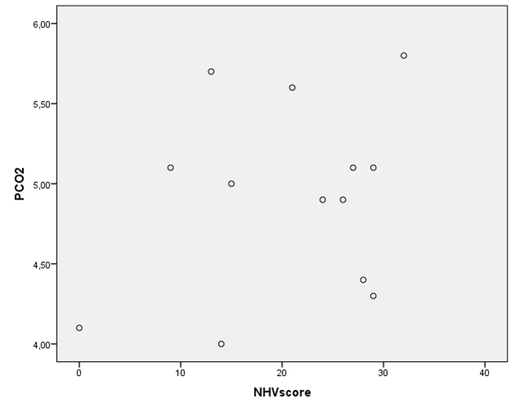
Relatie dysfunctional breathing en hypocapnie
Vals positief voor hypocapnie obv NHV
Vals negatief voor hypocapnie obv NHV

Slide 24
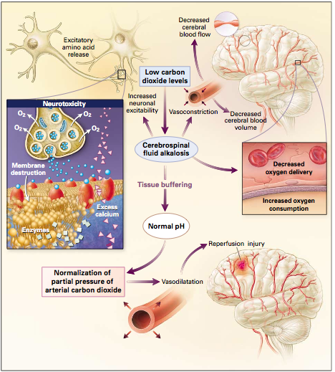
Hypocapnie geeft bronchoconstrictie
JG Laffey & MB Kavanagh. Hypocapnia. N Eng J med.2002; 347: 43-53
F.J. van den Elshout, et al. Effects of hypercapnia and hypocapnia on respiratory resistance in normal and asthmatic subjects. Thorax 1991; 46: 28-32

Slide 25
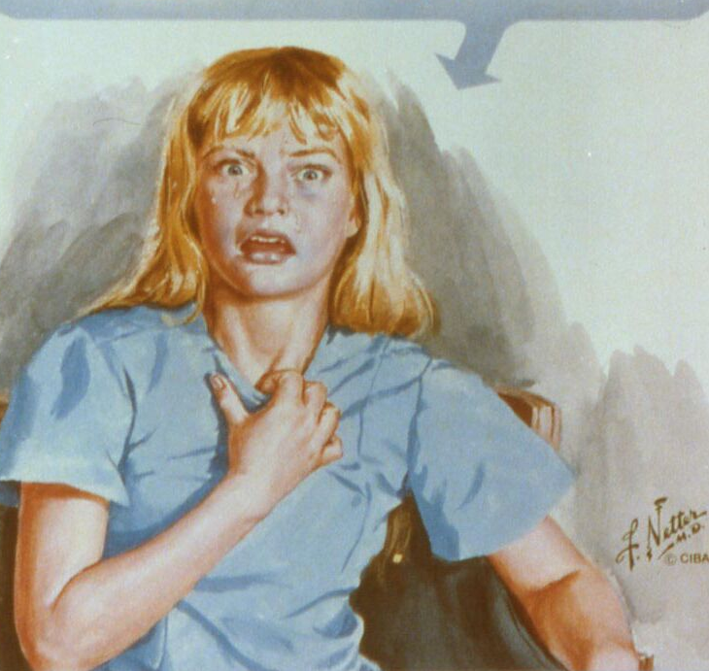
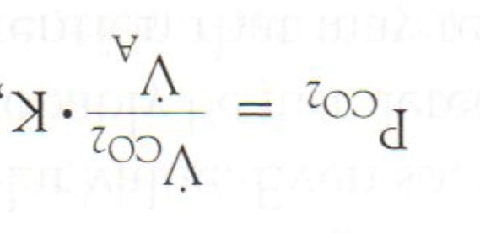
Effect toename alveolaire ventilatie op P_{a}CO₂
Ventilatie toename van 10% geeft reeds hypocapnie!
= 1 ademteug extra/ minuut
J.B. West. Respiratory physiology; the essentials. Lippincott, Williams& Wilkins

Slide 26

Breathing exercises for dysfunctional breathing/ hyperventilation syndrome in adults (Review)
JM Harvey, et al. The Cochrane Database of Systematic Reviews 2013, Issue 5
Methods:
1 RCTs (30 participants were included in the review)
Authors’ conclusions:
No reliable conclusions can be drawn from this small, isolated study.
Breathing exercises for adults with asthma (Review)
Freitas DA, et al. The Cochrane Database of Systematic Reviews 2013, Issue 10
Methods:
13 RCTs (906 participants were included in the review)
Authors’ conclusions:
Even though individual trials reported positive effects of breathing exercises, no conclusive evidence in this review supports or refutes the efficacy of such intervention in the treatment of adult patients with asthma.

Slide 27
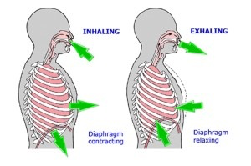
Breathing exercises for dysfunctional breathing in asthma: a randomised controlled trial
Thomas M, et al. Thorax 2003; 58: 110-115
Methods:
RCT, 33 patients included
Breathing training by physiotherapist versus education by asthma nurse

Slide 28
9/16 van de experimentele groep = 56% verbeterd > 0.5 punt op de AQLQ
Thomas M, et al. Breathing exercises for dysfunctional breathing in asthma: a randomised controlled trial. Thorax 2003; 58: 110-115

Slide 29
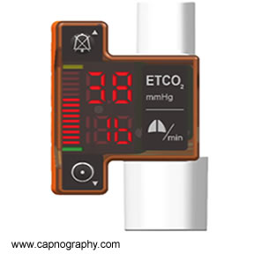
Controlling asthma by training of capnometry-assisted hypoventilation (CATCH) vs slow breathing
Ritz T, et al. Chest 2014; 146: 1237-1247
Methods:
RCT, 116 patients included
capnometry-assisted respiratory training versus slow breathing

Slide 30
Ritz T, et al. Controlling asthma by training of capnometry-assisted hypoventilation (CATCH) vs slow breathing. Chest 2014; 146: 1237-1247

Slide 31


Slide 32

Fysieke activiteit bij astma

Slide 33

Prevalentie fysieke inactiviteit
A. van ‘t Hul, S. Frouws, E. van den Akker, R. van lummel, A. Starrenburg, A. van Bruggen, GJ Braunstahl, H. in ‘t Veen. Decreased physical activity in adults with bronchial asthma. Respiratory Medicine 2016; 114: 72-77

Slide 34
Distribution of the PAL categories in asthmatics and healthy controls

Slide 35
Scatterplot of PAL and BMI in the asthmatics

Slide 36
Daily time spent at vigorous exercise in health controls and asthmatics subdivided according to the ACQ category

Slide 37
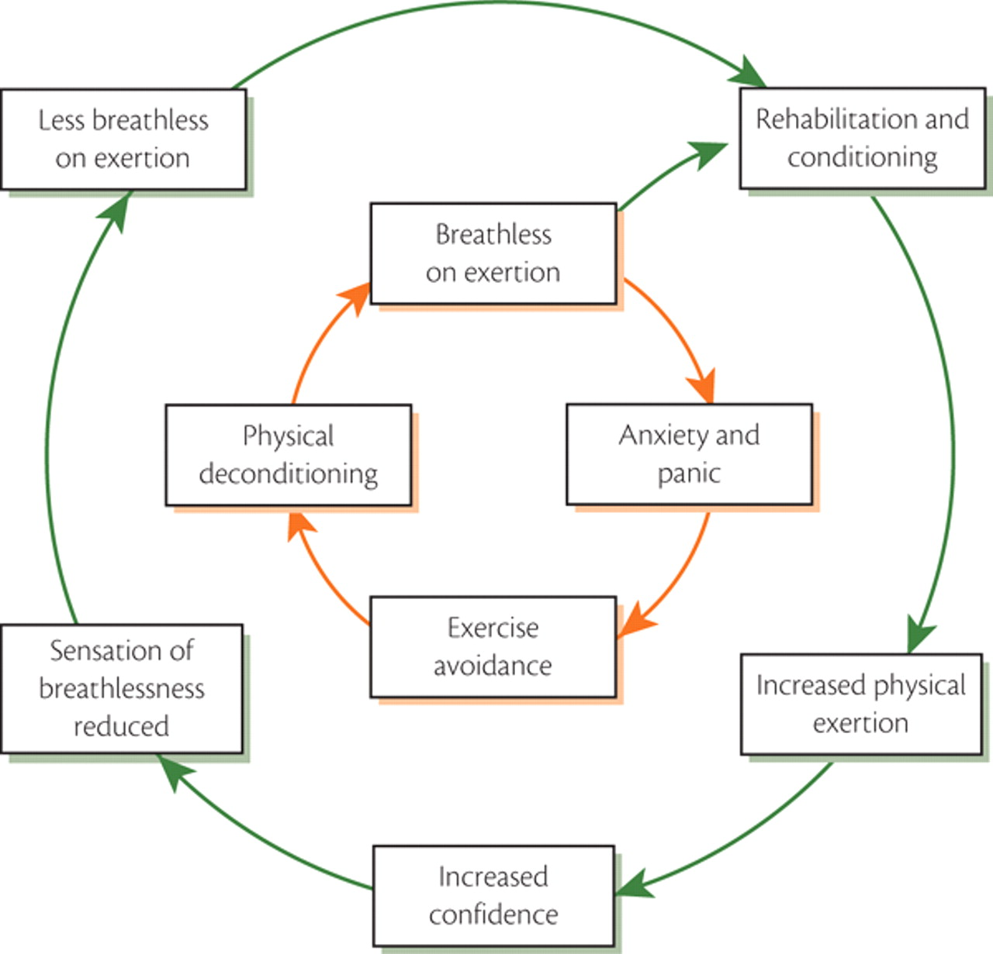
Fysieke activiteit en deconditionering

Slide 38
Exercise training

Slide 39
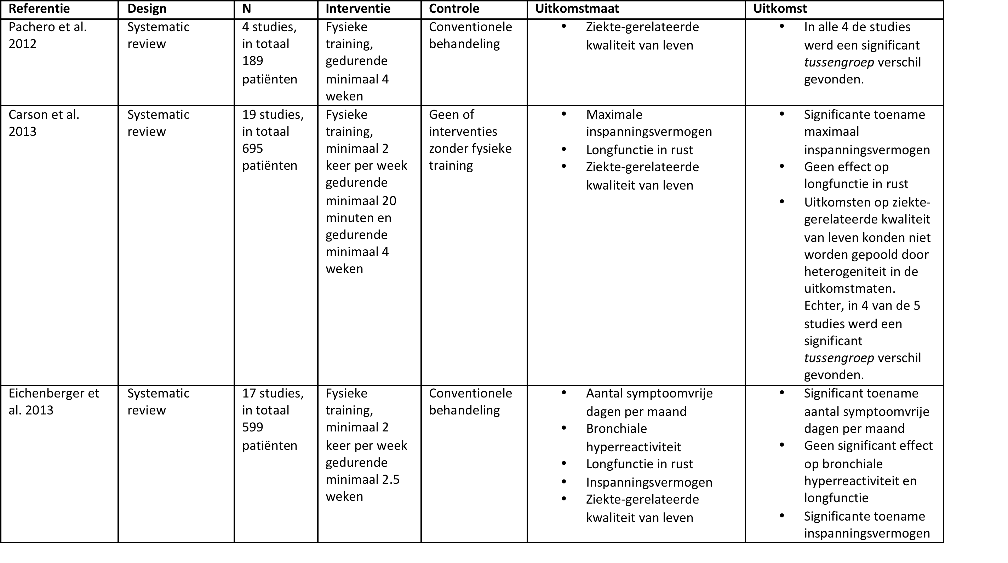
Systematic reviews naar effecten van inspanningstraining bij astma

Slide 40
Clinical trials naar effecten van inspanningstraining bij astma

Slide 41
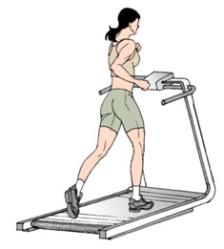
Mechanisme van inspanningstraining om gezondheidstoestand van mensen met astma te verbeteren?
Franca-Pinto A., et al. Aerobic training decreases bronchial hyperresponsiveness and systemic inflammation in patients with moderate or severe asthma: a randomised controlled trial. Thorax 2015; 70: 732-739.

Slide 42
Inspanningscapaciteit en kwaliteit van leven
Franca-Pinto A., et al. Aerobic training decreases bronchial hyperresponsiveness and systemic inflammation in patients with moderate or severe asthma: a randomised controlled trial. Thorax 2015; 70: 732-739.

Slide 43
BHR en serum proinflammatoire cytokines
Franca-Pinto A., et al. Aerobic training decreases bronchial hyperresponsiveness and systemic inflammation in patients with moderate or severe asthma: a randomised controlled trial. Thorax 2015; 70: 732-739.

Slide 44
Study protocols naar effecten van inspanningstraining bij astma
Bacon, S.L., et al., The effects of a multisite aerobic exercise intervention on asthma morbidity in sedentary adults with asthma: the Ex-asthma study randomised controlled trial protocol. BMJ Open, 2013. 3(6).
Evaristo, K.B., et al., Comparison between breathing and aerobic exercise on clinical control in patients with moderate-to-severe asthma: protocol of a randomized trial. BMC Pulm Med, 2014. 14: p. 160.
Majd, S., et al., Protocol for a feasibility study to inform the development of a multicentre randomised controlled trial of asthma-tailored pulmonary rehabilitation versus usual care for individuals with severe asthma. BMJ Open, 2016. 6(3): p. e010574.
Freitas, P.D., et al., The effects of exercise training in a weight loss lifestyle intervention on asthma control, quality of life and psychosocial symptoms in adult obese asthmatics: protocol of a randomized controlled trial. BMC Pulm Med, 2015. 15: p. 124.

Slide 45
Bacon SL, et al. The effects of a multisite aerobic exercise intervention on asthma morbidity in sedentary adults with asthma: the Ex-asthma study RCT protocol. BMJ Open 2013; 3: e003177

Slide 47

Resultaten:
ACQ klinisch relevant verbeterd
SABA gebruik omlaag
Afname depressie symptomen
Bacon SL, et al. The effects of a multisite aerobic exercise intervention on asthma morbidity in sedentary adults with asthma: the Ex-asthma study RCT protocol. BMJ Open 2013; 3: e003177

Slide 48

Asthma symptoms can be improved by diet and exercise in non-obese patients
Dr Louise Lindhardt Toennesen (MD, PhD) from Bispebjerg University Hospital, Copenhagen, Denmark

Slide 49
Methods
149 patients who were randomly assigned to one of four groups:
Group 1 were asked to follow a diet that was high in protein and with a low glycaemic index (low GI). They were also asked to eat at least six portions of fruit and vegetables per day
Group 2 took part in exercise classes three times a week at hospital. These classes included bursts of high intensity activity designed to raise the heartrate, interspersed with more gentle activity.
Group 3 took part in the exercise classes and followed the diet
Group 4 did neither

Slide 50
Results
A total of 125 people remained in the study for the full eight weeks.
They found that the high intensity training was safe for patients.
On average, those who took part in the exercise and followed the diet rated their asthma symptom score 50% better compared to the control group.
Those patients who only followed either the exercise programme or the diet programme on average rated their asthma symptom score 30% better compared to the control group, but this result did not reach statistical significance.

